Slide 1
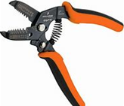
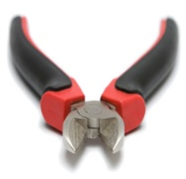
Basic Hand And Power Tools
1. Wire stripper
- It is used for stripping and cutting of wires.
2.Side cutter
- It is used for cutting and stripping of wires.

Slide 2
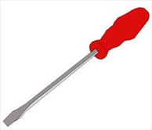
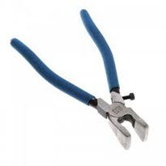
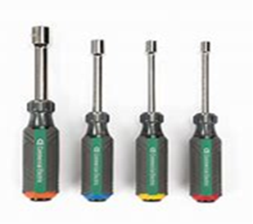
3. Screwdrivers
- It is used for loosening and tightening of screws.
4. Pliers
- It is used for cutting of wires.
5. Nut drivers.
- It is used for loosening and tightening of bolts and nuts.

Slide 3
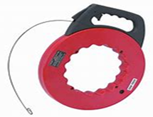

6. Fishing tool
- It is used for pulling electrical wires.
7. Hacksaw
- It is used cutting of pvc pipes and cables.

Slide 4
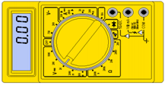
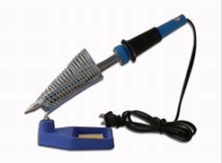
Power tools
1. Meter tester
- It is used for checking the flow of current on the wires.
2. Soldering
- It is used for joining of wires.

Slide 5

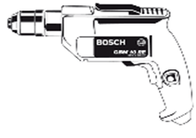
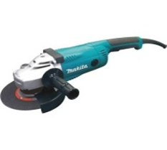
3. Cordless hand drill
- It is used for loosening and tightening of screws and nuts.
4. Power hand drill
- It is used for loosening and tightening of screws and nuts.
5. Angle grinder
- It is used for grinding walls.

Slide 6
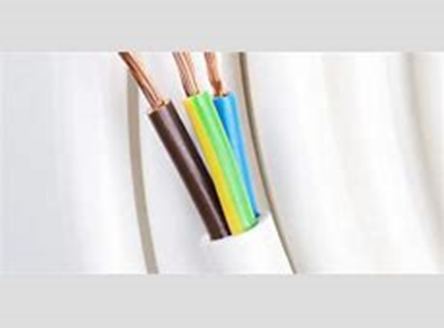
Colour coding of a 3 – core cord
Coding
1. Live – Red or brown colour
2. Neutral – Black or blue colour
3. Earth – Yellow & green colour or copper wire
Demonstration Video :
-
Feedback : Activity

Slide 7


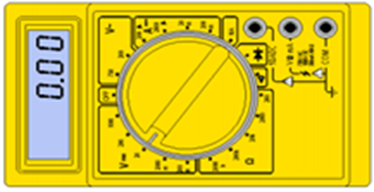

Kwa Thema Skills School
Subject : Maintenance Marks: 15
Grade : Year 2 Time : 30mins
Date :
Question : 1
1. Identify the power tools
.1 ________________________ 1.2 _______________________
1.3 _______________________ 1.4 ________________________

Slide 8
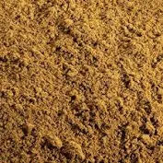
Question:2
1.Identify the following building and plastering materials.
1.____________________ 2.______________________
3.___________________ 4. ______________________
5. ______________________ 6. ______________________

Slide 9
Question:2
1.____________________ 2.______________________
3.___________________ 4. ______________________
5. ______________________ 6. ______________________

